Slide 1
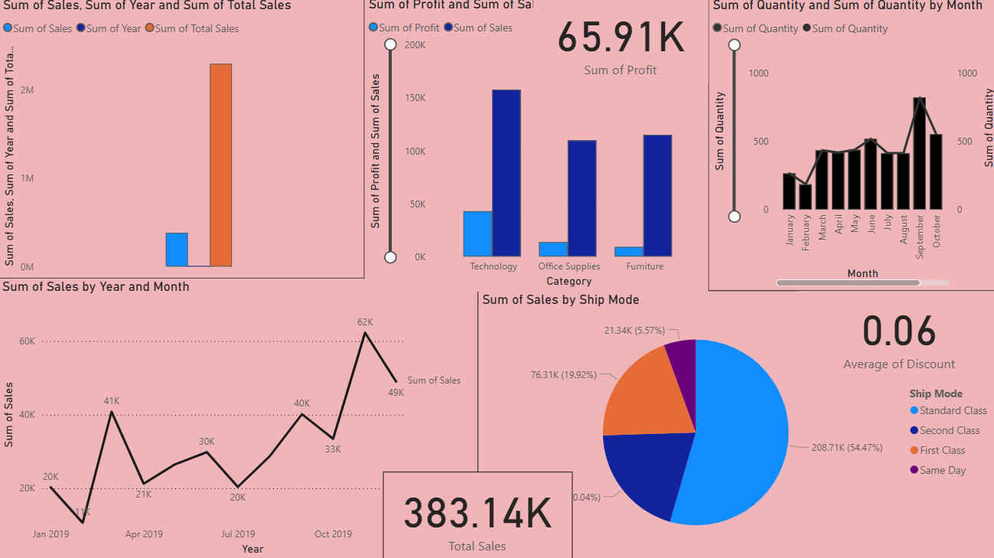
Sales Analysis Dashboard – Power BI Project
Presented by: Ritik Bhardwaj

Slide 2
PROJECT OBJECTIVE
• Analyze sales performance using Power BI.
• Apply DAX Measures & Power Query Transformations.
• Build an interactive and visually rich dashboard.
• Identify insights for business decision-making.

Slide 3
Dataset Description
• Time Period: 2016–2019
• Dataset includes: Orders, Sales, Profit, Discount, Customer Info.
• Key Columns: Order Date, Product, Category, Region, Customer, Sales, Profit.
• Used for KPI calculations, trends, segment analysis & forecasting.

Slide 4
KEY KPI’S
• Total Sales
• Total Profit
• Total Quantity
• Average Discount
• Sales With vs Without Discount
• YOY Growth % Trend
• Running Total Sales

Slide 5
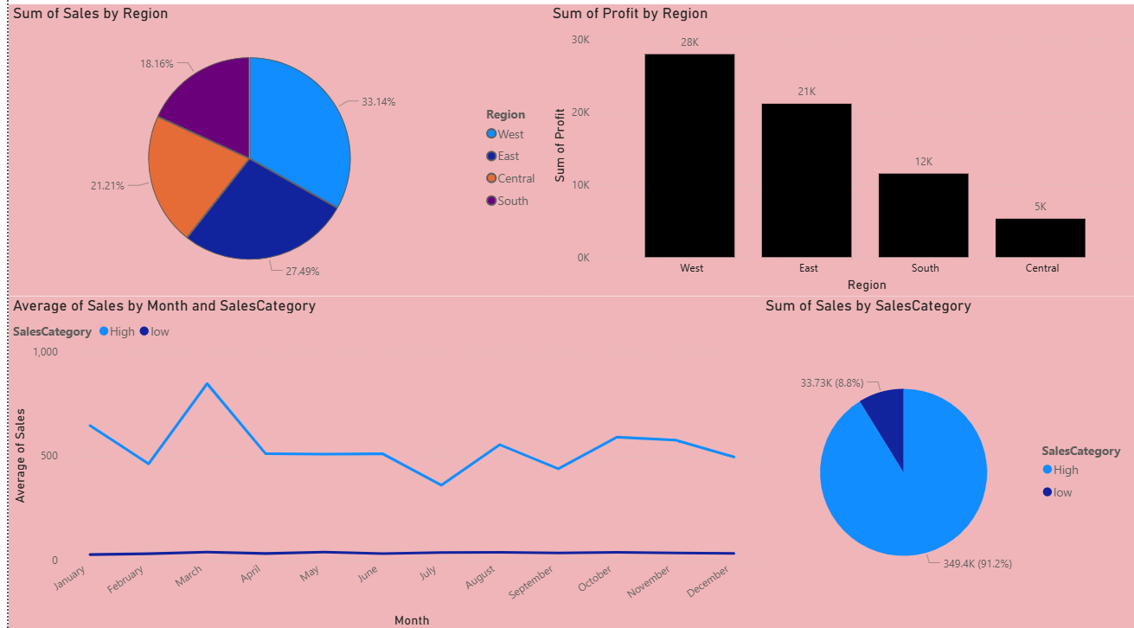
SALES TREND & FORECASTING
• Yearly & Monthly Sales Trends analyzed.
• Forecasting applied using Power BI Analytics Panel.
• Trend reveals clear growth & future sales prediction.

Slide 6
Category Insights
• Sales by Category & Sub-category.
• Profit distribution across product lines.
• Identification of top-performing categories.

Slide 7
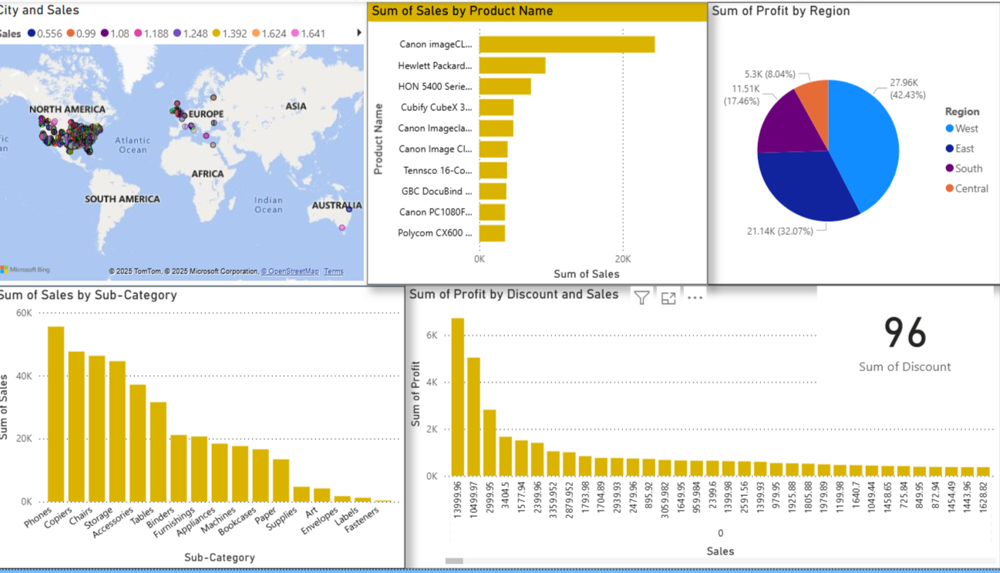
REGION INSIGHTS
• Region-wise Sales Comparison.
• Profit variations across regions.
• Region Contribution using Pie/Map visuals.

Slide 8
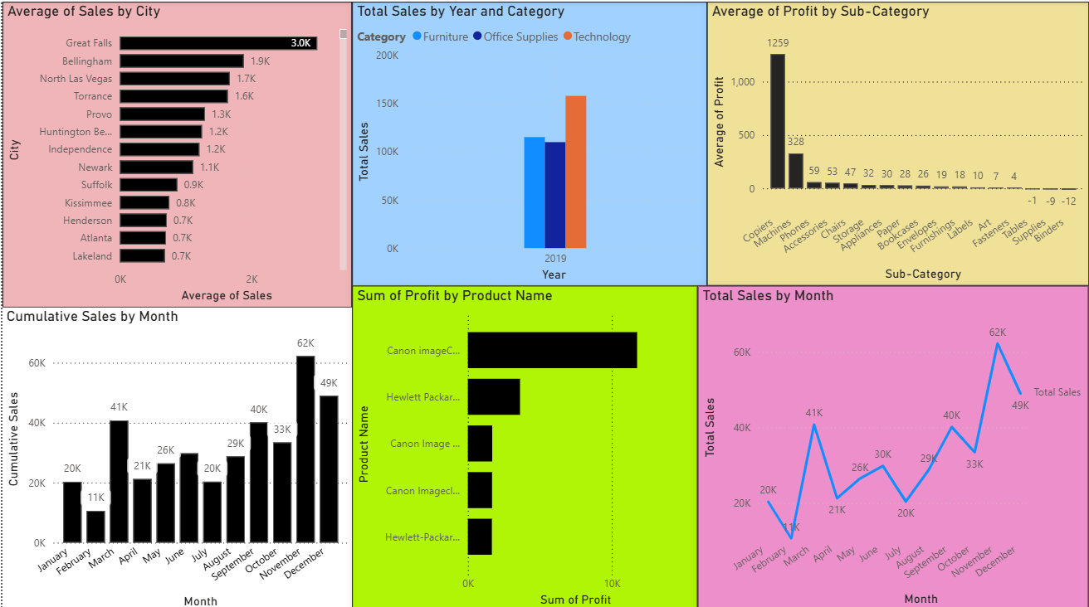
Customer Insights
• Customer segmentation (Consumer, Corporate, Home Office).
• Top 5 customers by sales.
• Customer name split into First/Last Name for analysis.

Slide 9
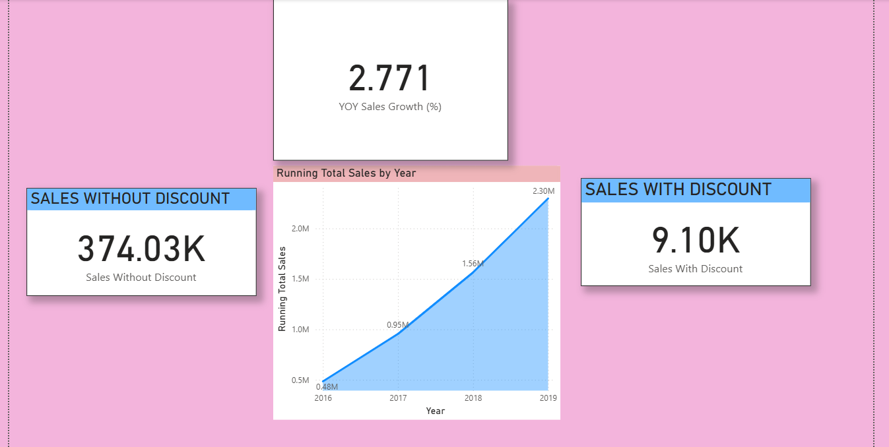
Running Total & YOY Growth
• Running Total Sales created using DAX.
• YOY Growth % measure highlights yearly improvement.
• Useful for long-term business projection.

Slide 10
Summary & Conclusion
• Sales shows strong growth across years.
• Key categories and regions identified.
• Dashboard supports strategic data-driven decisions.
• Forecast suggests continued upward trend.

